Slide 1
Academic Alert System

Slide 2
Introduction
Carla Bates
  Programmer/Analyst
  Create web applications
  November 1996

Slide 3
Introduction, cont’d.
PhD Information Sciences and Learning Technologies
  University of Missouri - Columbia
MS Information Sciences and Technology
  Missouri S&T
  May 2005
BS Management Systems
  Missouri S&T
  May 1996

Slide 4
Paper Form
Instructor
Department Chair
Department of Advisor
Advisor

Slide 5
Purpose
Improve student academic success
Improve communication
Reduce time student is notified about doing poorly
Inform students how to improve grade

Slide 6
Student
Advisor
Instructor
Promptly respond to academic alerts.
Communicate with students who receive academic alerts.
Contact academic advisor to discuss recommended action(s).
Initiate alerts for students not meeting academic course requirements.
Follow up with students on suggested corrective action(s).
Take action, as recommended by your advisor, and communicate the results.
Update the status of the academic alert.

Slide 7
Process
Instructor issues alert
  Includes issues
  Includes recommendations
  Includes consequences

Slide 8
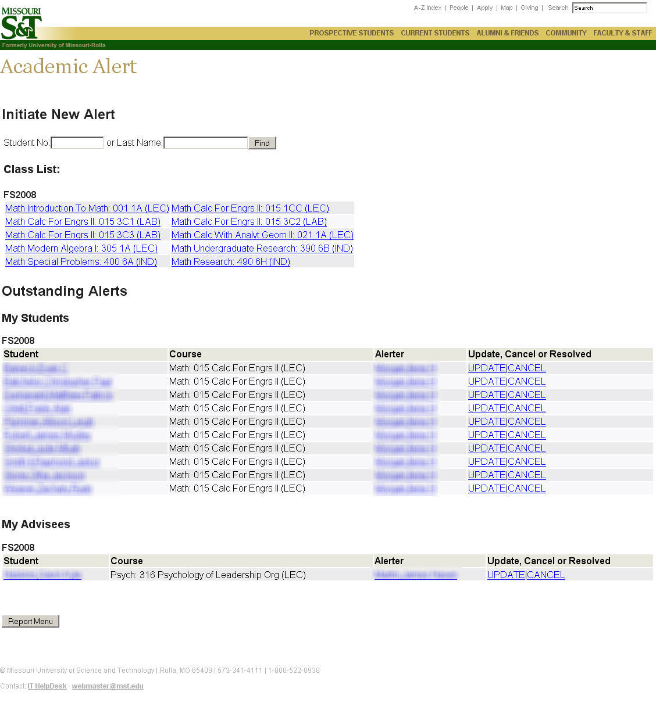

Slide 9
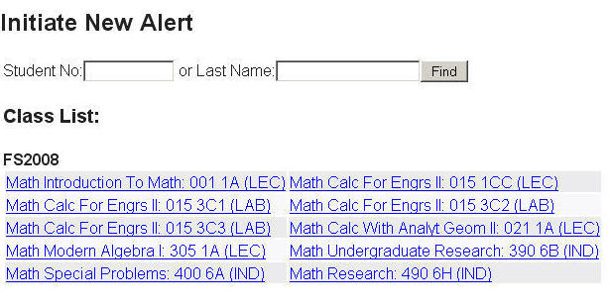

Slide 10
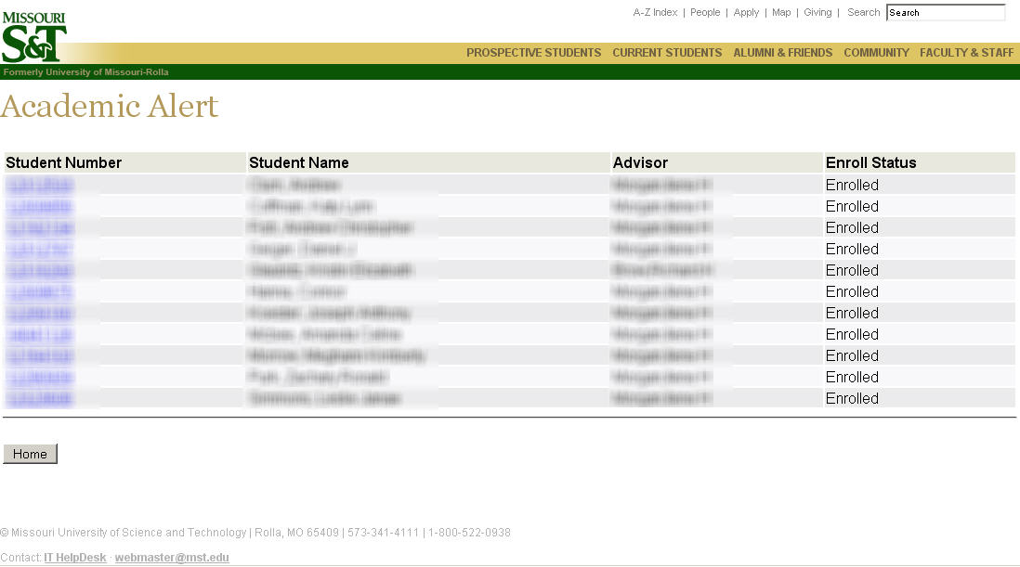
Students in a Course

Slide 11
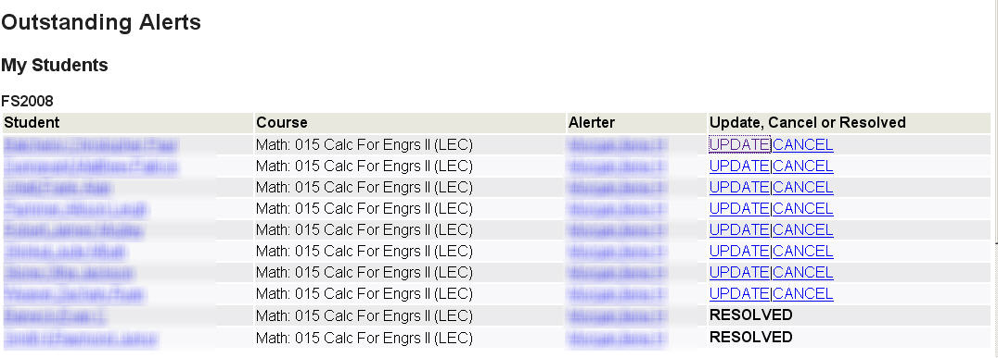

Slide 12
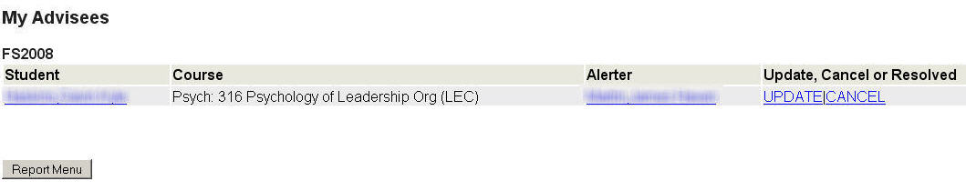

Slide 13
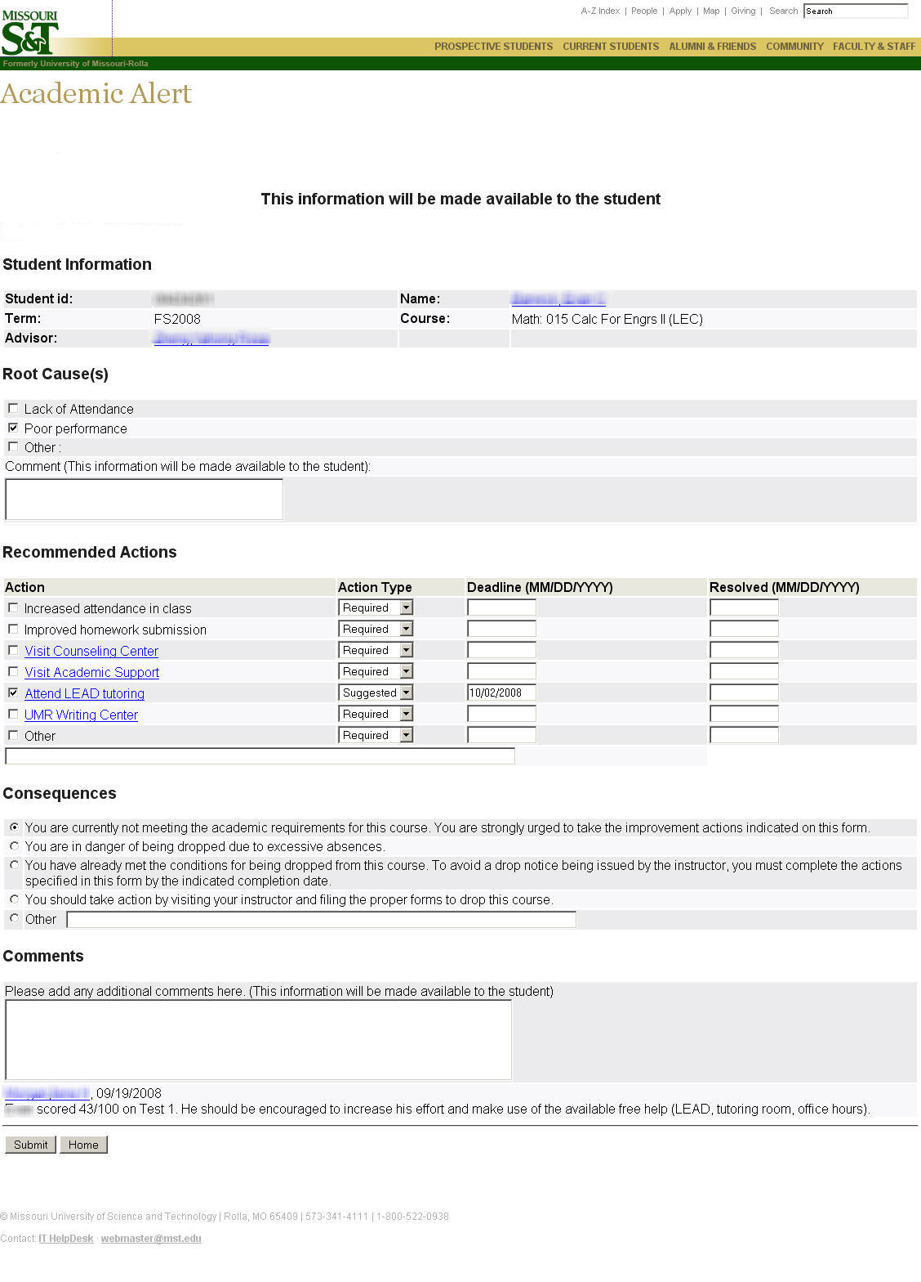

Slide 14
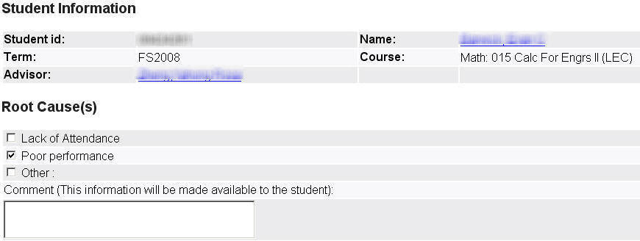

Slide 15
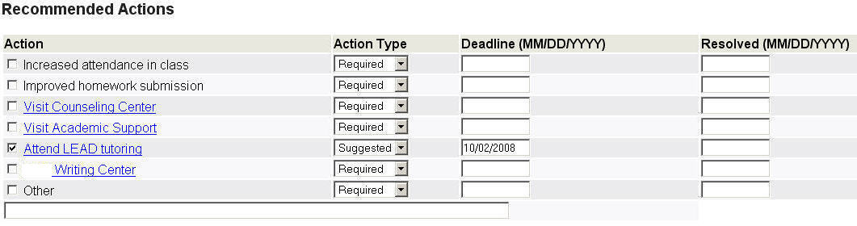

Slide 16
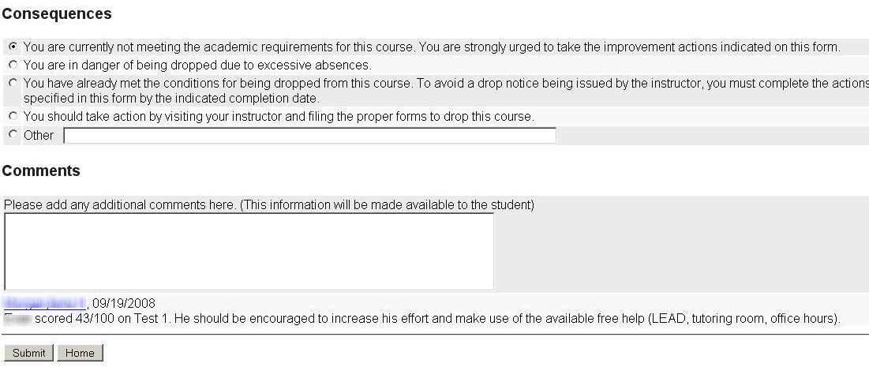

Slide 17
Process (continued)
Email sent
  Instructor
  Student
  Student’s Advisor

Slide 18
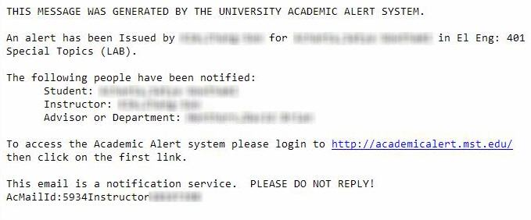
Instructor Email

Slide 19
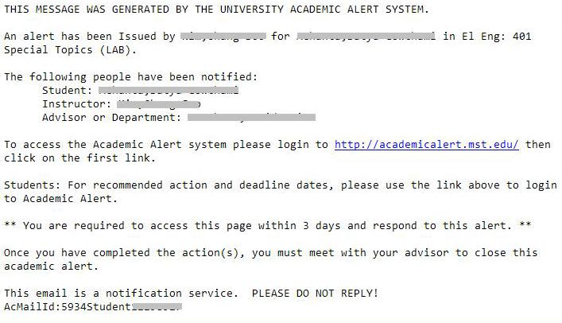
Student Email

Slide 20
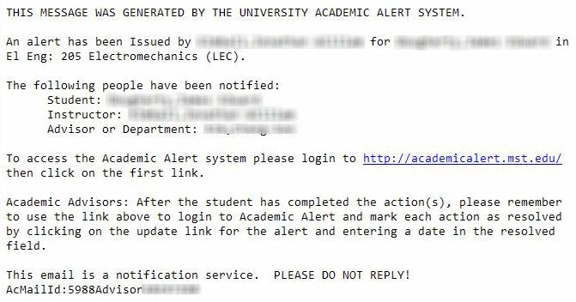
Advisor Email

Slide 21
Process (continued)
Meeting
  Student and advisor should get together
  Discuss recommendations from instructor
Closing alert
  Recommendations completed
  Instructor or advisor

Slide 22
Reminders
Advisor
  Deadlines missed
  Student doesn’t view alert

Slide 23
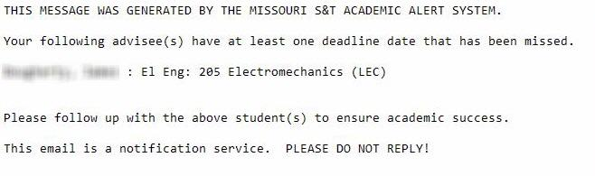
Advisees Missed Deadline

Slide 24
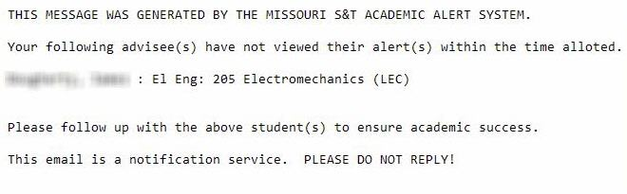
Advisees Not Review Alert

Slide 25
Reports

Slide 26
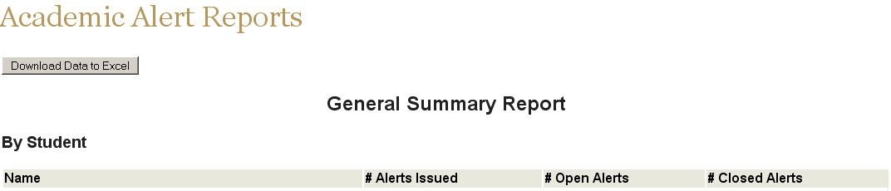
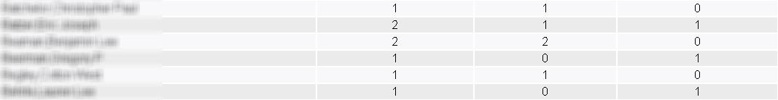
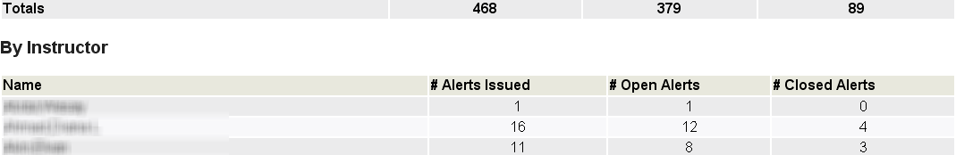

Slide 27
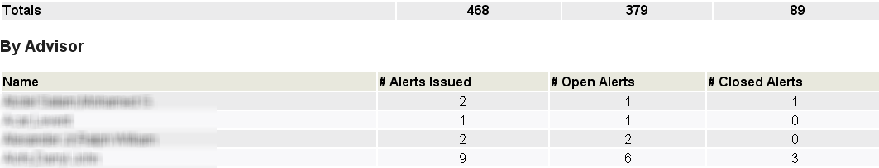
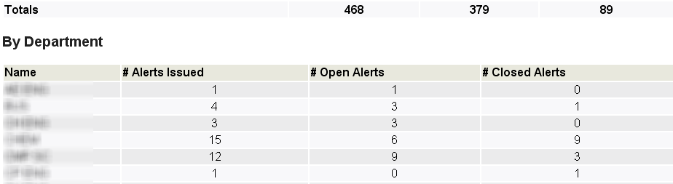

Slide 28
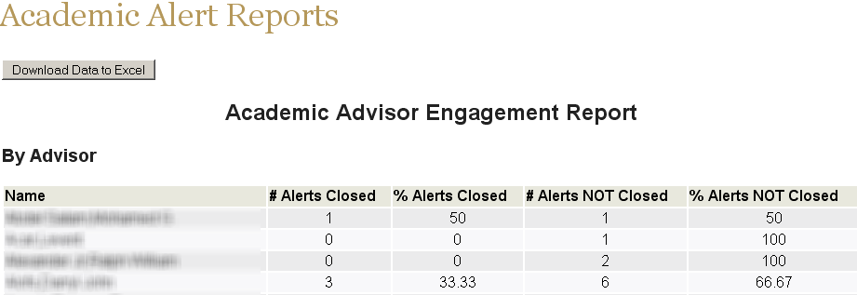
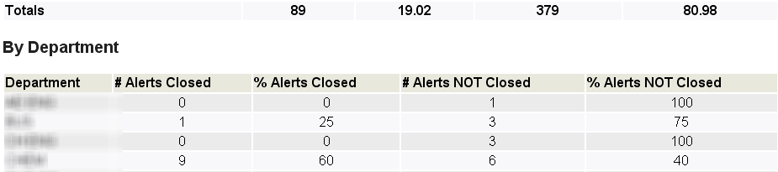

Slide 29
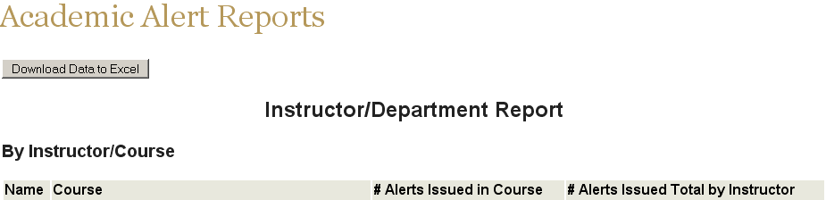
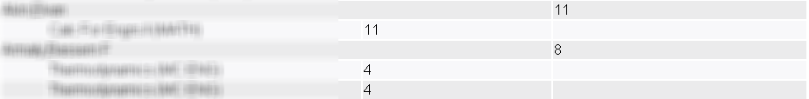
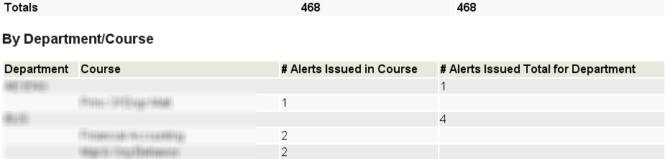
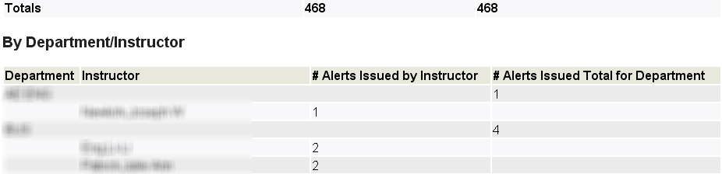

Slide 30
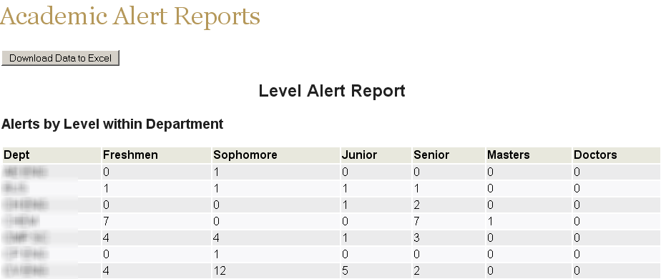

Slide 31
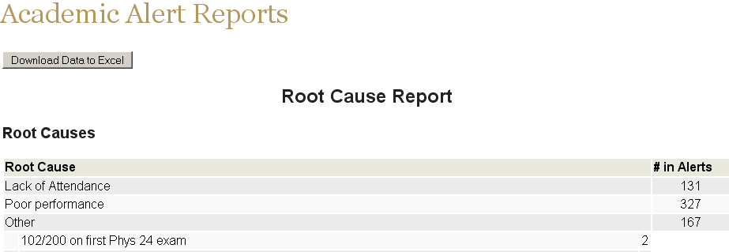
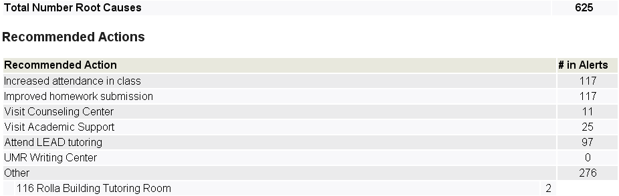

Slide 32
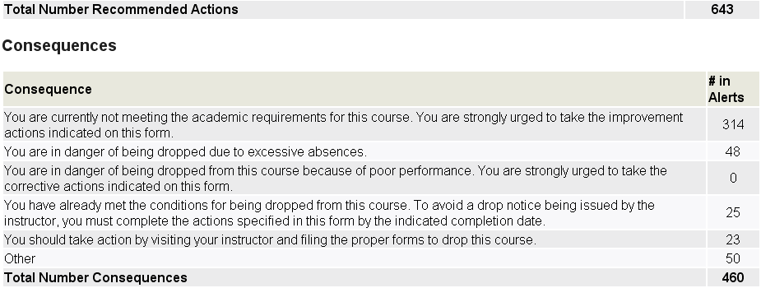

Slide 33
Reports
All Students
Closed Alerts
Performance

Slide 34
Alert Data

Slide 35
Alerts by Level

Slide 36
Mid-term Grade vs. Final Grade

Slide 37
Other Findings
99% of probationary students received alerts
Continued increase in use
  During the 2006-07 academic year:
    Increased instructor use (40%)
    Increased advisor use (3%)
* Data from Undergraduate Study Office

Slide 38
Issue still resolving
2006-07
  72% of alerts were not formally closed-out
  When closed, students did better
Working on ensuring alerts are closed.
  Modifying email
  More “advertising”
* Data from Undergraduate Studies Office

Slide 39
Questions?

